Slide 1
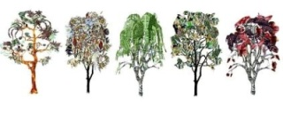
The “What’s” & “How’s” of Photosynthesis
the process a plant uses to combine sunlight, water, and carbon dioxide to produce oxygen and sugar (energy). This takes place in the chloroplast.
Photosynthesis occurs in plants, algae, and many species of Bacteria.

Slide 2
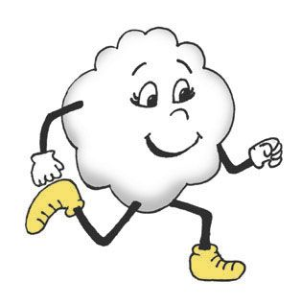
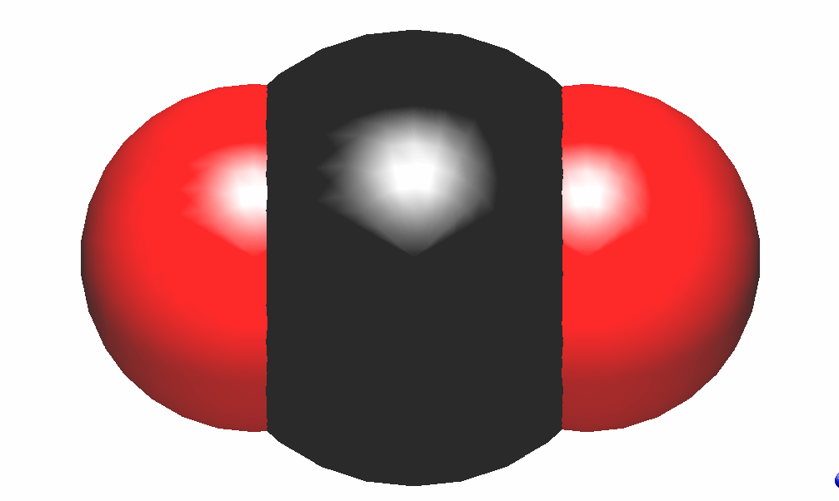
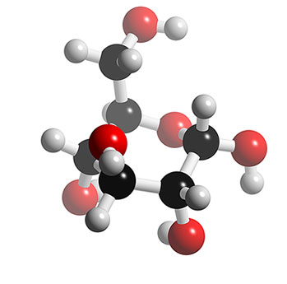
Equation*
6H₂O+6CO₂ + SUNSHINE→6O₂+C₆H₁₂O₆
+
→
+
+

Slide 3
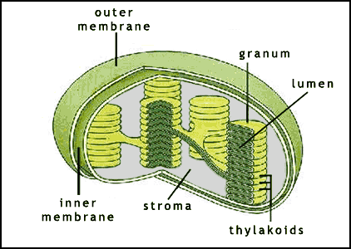
Lets get started !
Inside the chloroplast you have stacks of thylakoids.
The Chlorophyll is located in the thylakoids which absorb sunlight.
Water is also taken in by the thylakoids.
→
+

Slide 4
Light dependent Rxn
Once the Sunlight is captured and transferred across the thylakoid membrane, water is broken down and oxygen is released. Energy along the thylakoids is stored into ATP.
This is the first half of photosynthesis called the light dependent reaction.
→

Slide 5
ATP (adenosine triphosphate)
the main energy-storing molecule in living organisms.
ATP is then transported throughout the chloroplast and used to provide the chemical energy necessary to power other the second reaction in photosynthesis.
ATP
NADPH

Slide 6
Light independent Reaction (Calvin Cycle)
Takes place in the stroma within the chloroplast and converts CO₂ to sugar.
Does not need light to function, but it does need ATP as an energy source.
1 Glucose (C₆H₁₂O₆) Molecule
6 Carbon Dioxide Molecules

Slide 7
REACTANTS & PRODUCTS
Reactants-
Sunlight
Water
Carbon dioxide
Products-
Oxygen
Glucose

Slide 8
PHOTOSYNTHESIS
Photosynthesis uses solar energy, water, carbon dioxide, and turns it into sugar and oxygen for chemical energy. This contributes to the life of plants .

Slide 9
Photosynthesis cell
ADP
NADP+
chlorophyll
thylakoid
Light Ind. Rxn
-Stroma
Grana [
ATP
Light Dep. Rxn
NADPH

